Slide 1
Computational Methods II
(Elliptic)
Week 4- Lecture 1 and 2
Dr. Farzad Ismail
School of Aerospace and Mechanical Engineering
Universiti Sains Malaysia
Nibong Tebal 14300 Pulau Pinang

Slide 2
Overview
We already know the nature of hyperbolic and parabolic PDE’s.
Now we will focus on elliptic PDE.
The elliptic PDE is a type of PDE for solving incompressible flow.

Slide 3
Overview (cont’d)
Elliptic PDE’s are always smooth
Easier to obtain accurate solutions compared to hyperbolic problems, the challenge is in getting solutions efficiently.
Unlike hyperbolic and parabolic problems, information is transmitted everywhere

Slide 4
Overview (cont’d)
The model problem that will be discussed is
Note that the problem is now 2D but with no time dependence
Poisson Eqn
Laplace Equation

Slide 5
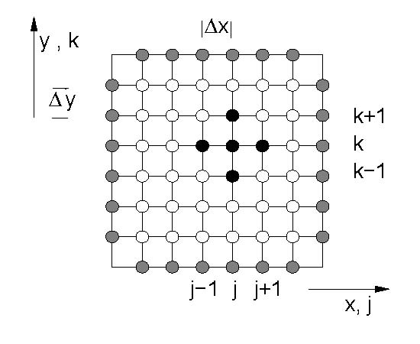
Overview (cont’d)

Slide 6
Overview (cont’d)
For special case where the grid sizes in x and y is identical
Solve for u(j,k) such that r(j,k)=0, yielding a system of
matrix Mu = 0
Assume M intervals for each direction, Gaussian elimination method needs operations in 2D
is the residual associated with cell (j,k)

Slide 7
Iteration Method
Solving it directly is to expensive, usually an iteration method is employed.
The simplest iteration method is the point Jacobi method – based on solving the steady state of parabolic pde
Solve iteratively for until

Slide 8
Iteration Method (cont’d)
The superscript n denotes pseudo-time, not physical time
ω is the relaxation factor, analogous to μ
The first thought is to achieve steady-state as quickly as possible, hence choosing a largest ω consistent with stability
Not a good idea since we need to know what is the best choice for ω

Slide 9
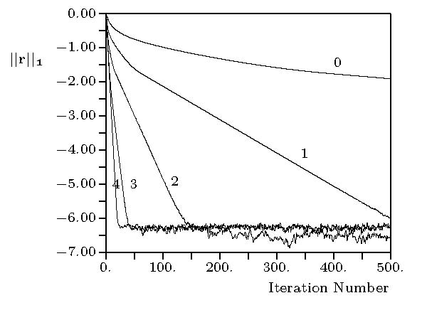
Typical Residual Plot

Slide 10
Residual Pattern
Plot of convergence history
Has three distinct phases
First phase, the residual decays very rapidly
Second phase decays linearly on the log-plot (or exponentially in real plot)
Third phase is ‘noise’, since randomness has set in
- after a while residuals become so small that they
are of the order of round-off errors

Slide 11
Residual Pattern (cont’d)
Sometimes the residual plot would ‘hang’ up
Usually due to a ‘bug’ in the code
To save time, apply a ‘stopping’ criterion to residual
But not easy to do so, need to understand errors

Slide 12
Analyzing the Errors
We want know how the iteration errors decay.
Expand the solution as
The first term on the RHS is the solution after infinite number of iterations
The second term on the RHS is the error between the solution at iterative level n and after infinite iterations
Get the best solution if error is removed

Slide 13
Analyzing the Errors (cont’d)
Substitute the error relation into the iteration method.
Converge solution gives zero residual, hence
Iterations for error

Slide 14
Analyzing the Errors (cont’d)
Shows that error itself follow an evolutionary pattern
This is true for all elliptic problems
Remarkably, we can determine how the error would behave even if we do not know the solution

Slide 15
Analyzing the Errors using VA
In 2D, von Neumann analysis (VA)
Insert this into the error equation
Yields the amplification factor for the errors

Slide 16
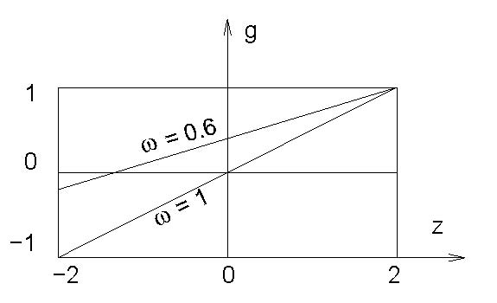
Amplification factor for Point Jacobi Method
What does the figure tell you ???

