Slide 1
Computational Methods II (Elliptic)
Week 4- Lecture 2
Dr. Farzad Ismail
School of Aerospace and Mechanical Engineering
Universiti Sains Malaysia
Nibong Tebal 14300 Pulau Pinang

Slide 2
G for Errors using Point Jacobi (cont’d)
The plot shows how the errors decay for various error modes (in terms of sines and cosines)
Consider 1D situation – let there be M+1 points on a line giving M intervals. The errors can be expressed as
where m = 1,2, .., M-1

Slide 3
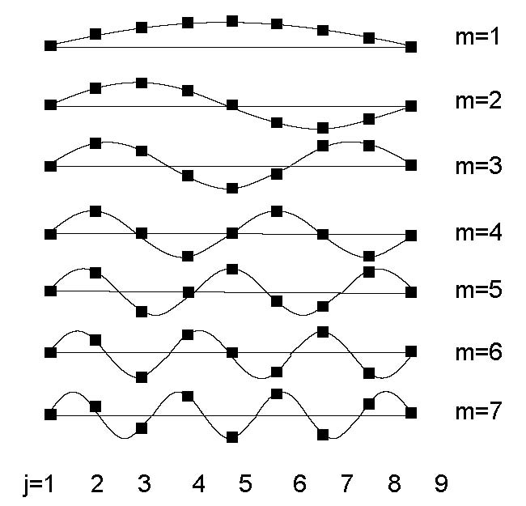
Error Modes for M=8
Seven possible error modes on a 1D mesh with
eight intervals –
Lowest to highest frequencies.

Slide 4
Error Modes Analysis M=8
Any numbers satisfying f(0)=f(M)=0 can be represented as
This is a discrete Fourier Transform
In 1D, need only to consider the following set of discrete frequencies (lowest to highest)

Slide 5
2D situation
Consider 2D situation – let there be M+1 and N+1 points, giving M and N intervals in x and y directions
where m = 1,2, .., M-1. n=1,2,.. N-1.
Assume M=N, the highest and lowest frequencies correspond to

Slide 6
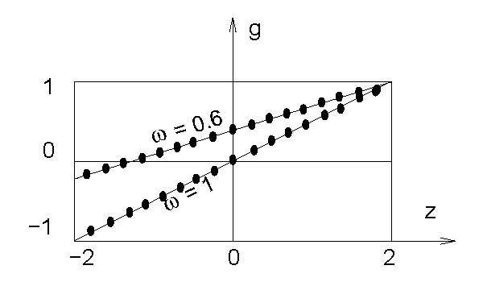
Discrete G versus z
- Each point corresponds to discrete error modes,
each error mode decays differently even for same
relaxation factor
- Note ZL = -ZR

Slide 7
Decay of Error Modes
In eliminating the errors, we do not care the sign of amplitude, just the magnitude of it – want g as small as possible
If 0 < |g| < 1 for ALL error modes, then we could say that we eventually will remove all the iteration errors and hence a steady state solution will be obtained.
However, the errors will be removed at different rates, with modes corresponding to the largest |g| (convergence rate) will be most difficult to be removed- dominant error mode

Slide 8
Decay of Error Modes (cont’d)
For ω=0.6, it is clear that ZR (lowest frequency) is the dominant error mode
Increasing ω, will decrease g until ω=1 – both lowest and highest frequency modes become dominant
Beyond ω > 1, ZL (highest frequency) modes become more dominant and |g| deteriorates.

Slide 9
Computational Cost
Recall for direct method (Gaussian Elimination) requires in 2D and in 3D.
Using point Jacobi iteration methods costs
in 2D and in 3D.
Can this be improved? Let say by one order magnitude?

Slide 10
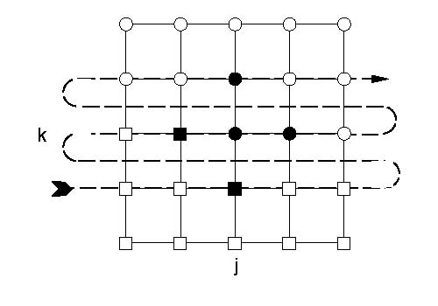
Gauss Seidel
When visiting node (j,k) at time level n+1, can use
information of nodes (j,k-1) at time level n and
(j-1, k) at n+1 (square nodes)
- This is Gauss-Seidel method

Slide 11
SOR Method
Coupling Gauss-Seidel with point Jacobi gives Successive Over- Relaxation (SOR) method
It can be shown that using VA, the convergence rate
Only consider real z such that

Slide 12
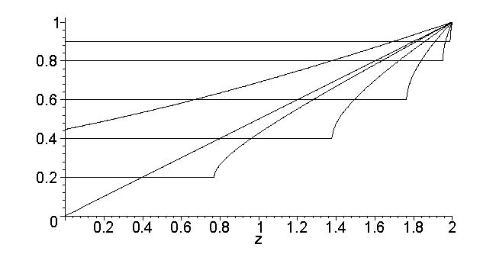
G versus z for SOR
- Note now z = [0,2]
Similar to Point Jacobi for ω less than or equal to 1
But improved convergence rate for ω > 1 (1.16, 1.36, 1.64,
1.81 ) -> STILL LOWEST FREQUENCY MODE IS DOMINANT

Slide 13
Discussion of Low Frequency Modes
We have seen that the low frequency modes are most difficult to get rid of for Point Jacobi and SOR methods
Moderate to high frequency modes are usually much easier to be removed.
This is the general behavior for almost all methods in solving elliptic PDE
Need to think out of the box

Slide 14
Multigrid (Brandt)
Use a hierachy of different grid sizes to solve the elliptic PDE –splitting the error modes
The low frequency error modes on a fine grid will appear as high frequency modes on a coarser grid.
Hence easier to be removed
But there is a problem with coarse grids.

Slide 15
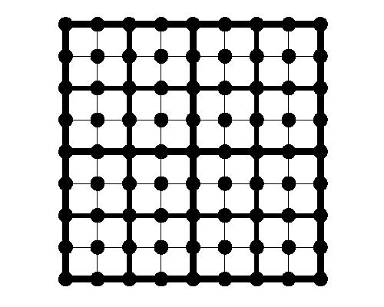
Multigrid Mesh
An 8 x 8 grid superimposed with 4 x 4 + 2 x 2 grid

Slide 16
Multigrid (cont’d)
Although coarse grids will remove the error modes quickly, but it will converge to an inaccurate solution
Need to combine the accuracy of fine grids with the fast convergence on coarse grids
As long as there are significant error modes in fine grid, coarse grid must be kept to work
Fine grids must ‘tell’ the coarse grids the dominant error modes and ask ‘advice’ on how to remove them – restriction operator

Slide 17
Multigrid (cont’d)
Coarse grids will give information on how to remove the dominant error modes to fine grids and ask for ‘advice’ regarding accuracy- prolongation operator
Communication between coarse-fine grids is the key
In between, perform relaxation (solving the steady state equation)

Slide 18
Story

Slide 19
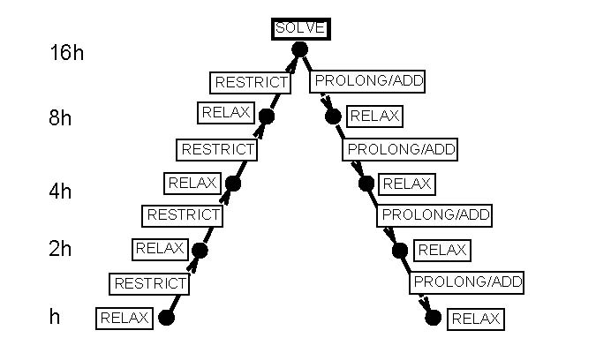
Multigrid V Cycle

