Slide 1
Scalar Conservation Law
Week 4 (Lecture 1 and 2)
Dr. Farzad Ismail
School of Aerospace and Mechanical Engineering
Universiti Sains Malaysia
Nibong Tebal 14300 Pulau Pinang

Slide 2
Preview
We have worked on linear advection equation using first order upwind method.
Problem is with severe numerical diffusion.
Before venturing into solving more difficult hyperbolic PDE, need to see if we gain any improvement using second order method (or higher).

Slide 3
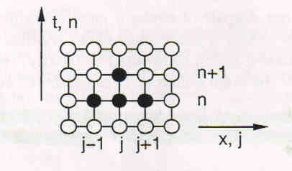
Linear Advection (LA) Revisited
Apply Lax-Wendroff scheme
This is a second order accurate scheme
(Prove in H/work problem)

Slide 4
Numerical Experiment for LA
A 1D test case with a variety of profiles being propagated downstream
First order upwind results
Second order Lax-Wendroff results
For stability, it can be shown that Lax-Wendroff scheme (and other explicit methods for solving hyperbolic PDE) is also bounded by

Slide 5
Behavior of Linear Advection
Using VN, it can be shown that

Slide 6
Summary of Hyperbolic PDE
Most stable schemes will attenuate the amplitude of the initial data and will get worse for propagation over large distances
All schemes will propagate waves with phase speeds that falsely depend on their wavenumber (or frequency). The waves will appear in positions that depart from the true position, so again large time observations are difficult

Slide 7
Summary of Hyperbolic PDE (cont’d)
For discontinuous data, all schemes either have produced spurious oscillations or have diffused the discontinuity
To achieve numerical stability, all explicit schemes must obey

